Slide 1
java.lang Package

Slide 2
Wrapper Classes
Look at primitive data elements as objects.
Primitive Data Type | Wrapper Class
boolean | Boolean
byte | Byte
char | Character
short | Short
int | Integer
long | Long
float | Float
double | Double

Slide 3
Example of a wrapper class
int pInt = 430;
Integer wInt = new Integer(pInt); // this is called boxing
int p2 = wInt.intValue(); // this is called unboxing

Slide 4
Auto boxing of Primitive Types
Conversion of primitive types to the object equivalent
Example:
int pInt = 430;
Integer wInt = pInt; // this is called auto boxing
int p2 = wInt; // this is called auto un boxing

Slide 5
String
  A string is a group of characters
  We use class String to define a string.
    Example: String name;
  Strings are bounded by double quotations.
    Example: String name = “Jane”;
  We can concatenate two or more strings using the operator +

Slide 6
String Constructors
  String s=new String (“ Hello ”);
  char c[]={‘a ’,’b ’,’c ’,’d ‘,’e ‘};
  String s=new String (c);
  String( char c[], int start, int numchars);
String s=new String (c,1,2);

Slide 7
Example
public class demo{
public static void main(String args[]) {
String s=new String("Hello");
char c[]={'h','e','l','l','o'};
String s1=new String(c);
String s2=new String(c,1,3);
System.out.println(s);
System.out.println(s1);
System.out.println(s2);
} }
Hello
hello
ell

Slide 8
String Class Methods
* public char charAt (int index)
String x = "airplane";
System.out.println( x.charAt(2) ); // output : 'r'
* public String concat(String s)
String x = "taxi";
System.out.println( x.concat(" cab") ); // output is "taxi cab"

Slide 9
public Boolean equals(String s)
String x = "Exit";
System.out.println( x.equals("Exit"));
// returns "true"
System.out.println( x.equals("exit"));
// returns "false"

Slide 10
public Boolean equalsIgnoreCase(String s)
String x = "Exit";
System.out.println( x.equalsIgnoreCase("EXIT"));
// returns "true"
System.out.println( x.equalsIgnoreCase("tixe"));
// returns "false"

Slide 11
* public int length()
String x = "01234567";
System.out.println( x.length() ); // returns "8“
* public String replace(char old, char new)
String x = "oxoxoxox";
System.out.println( x.replace('x', 'X') );
// output is "oXoXoXoX"

Slide 12
public String substring(int begin)
public String substring(int begin, int end)
String x = "0123456789";
System.out.println( x.substring(5) ); // output is "56789"
System.out.println( x.substring(5, 8)); // output is "567"

Slide 13
* public String toLowerCase()
String x = "A New Moon";
System.out.println( x.toLowerCase() ); // output is "a new moon“
* public String toUpperCase()
String x = "A New Moon";
System.out.println( x.toUpperCase() ); // output is "A NEW MOON"

Slide 14
* public String trim()
String x = " hi ";
System.out.println( x + "x" );
// result is " hi x"
System.out.println( x.trim() + "x");
// result is "hix"

Slide 15
Example
public class stringdemo{
public static void main(String args[]) {
String p="Java";
String s1=new String("Hello ");
String s=new String("hello ");
String s2=s1.toLowerCase();
String s3=s1.toUpperCase();
String s4=s1.trim();
System.out.println ("Lower case of s1 is : "+s2);
System.out.println("Upper case of s1 is : "+s3);
System.out.println("After removing white space in s1 : "+s4);
System.out.println(s1.equals(s));
System.out.println(s1.equalsIgnoreCase(s));
System.out.println("length of s1 is : "+s1.length());
System.out.println("Character of 4th position : "+s1.charAt(4));
} }
Lower case of s1 is : hello
Upper case of s1 is : HELLO
After removing white space in s1 : Hello
false
false
length of s1 is : 9
Character of 4th position : o

Slide 16
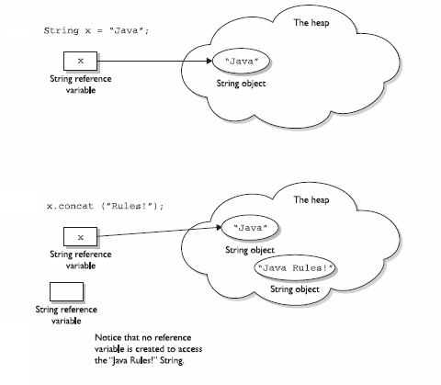
Strings are Immutable Objects

Slide 17
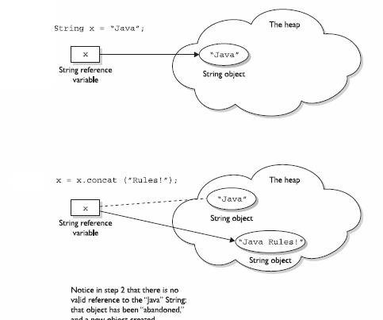

Slide 18
Example
public class demo{
public static void main(String args[]) {
String s=new String("Java");
s.concat("Rules");
System.out.println(s);
s=s.concat("Rules");
System.out.println(s);
}
}
Java
JavaRules

Slide 19
StringBuffer
In the previous section, we saw how the exam might test your understanding of String immutability with code fragments like this:
String x = "Java";
x.concat("Rules");
System.out.println("x = " + x); // output is "x = Java"
Because no new assignment was made, the new String object created with the concat() method was abandoned instantly.
We also saw examples like this:
String x = "Java";
x = x.concat("Rules");
System.out.println("x = " + x); // output is "x =JavaRules"

Slide 20
We got a nice new String out of the
deal, but the downside is that the old String
“Java” has been lost in the String pool, thus
wasting memory. If we were using a String Buffer instead of a String, the code would look like this:
StringBuffer sb = new StringBuffer("Java");
sb.append("Rules");
System.out.println("sb = " + sb);
// output is "sb = JavaRules"

Slide 21
String Buffer Methods
public append(String s)
StringBuffer sb = new StringBuffer("set ");
sb.append("point");
System.out.println( sb ); // output is "set point"

Slide 22
public insert(int offset, String s)
StringBuffer sb = new StringBuffer("01234567");
sb.insert(4, "---");
System.out.println( sb );
// output is "0123---4567"

Slide 23
public reverse()
StringBuffer sb = new StringBuffer("A man a plan a canal Panama");
System.out.println( sb );
// output is "amanaP lanac a nalp a nam A"

Slide 24
length() & setLength()
StringBuffer sb=new StringBuffer("Hello");
System.out.println(sb.length()); // output: 5
sb.setLength(8);
System.out.println(sb.length()); // output : 8

Slide 25
Example
public class Main{
public static void main(String args[]) {
StringBuffer sb=new StringBuffer("hai");
sb.append("hello");
System.out.println(sb);
System.out.println(sb.length());
sb.setLength(10);
System.out.println(sb.length());
System.out.println(sb.reverse());
sb.insert(2,"YY");
System.out.println(sb);
} }
haihello
8
10
ollehiah
YYollehiah

Slide 26
StringBuilder
StringBuilder is also mutable but not Thread Safe because methods are not synchronized.

Slide 27
StringBuilder Methods
public class StringBuilderDemo {
public static void main(String args[]){
StringBuilder sb=new StringBuilder("Hai");
sb.append("Hello");
System.out.println(sb);
System.out.println(sb.charAt(2));
sb.delete(3, 8);
System.out.println(sb);
sb.reverse();
System.out.println(sb);
sb.replace(0, 2, "abc");
System.out.println(sb);
} }
HaiHello
i
Hai
iaH
abcH

Slide 28
java.lang.Object

Slide 29
java.lang.Object
Class Object is the root of the class hierarchy.
Every class has Object as a superclass.
All objects, including arrays, implement the methods of this class.

Slide 30
java.lang.Object (con’t)
If a class doesn’t extend another class, then compiler extends it from Object.
For instance:
public class Lala { // stuff }
is created by the compiler as:
public class Lala extends Object{ // stuff}

Slide 31
java.lang.Object Methods
Thread control
  wait(), notify(), notifyAll()
General
  equals(), toString()
Not tested
  finalize(), hashCode(), clone(), getClass()

Slide 32
java.lang.Object Methods (con’t)
public boolean equals( Object object )
  should be overrided
  provides “deep” comparison
  not the same as ==
    == checks to see if the two objects are actually the same object
    equals() compares the relevant instance variables of the two objects

Slide 33
java.lang.Object Methods (con’t)
public String toString()
  should be overrided
  returns a textual representation of the object

Slide 34
java.lang.Math
Java supports integer and floating-point arithmetic directly. Higher-level math operations are supported through the java.lang.Math class.
Special Floating-Point Values
Value | Mathematical representation
POSITIVE_INFINITY | 1.0/0.0
NEGATIVE_INFINITY | -1.0/0.0
NaN | 0.0/0.0

Slide 35
Method | Argument type(s) | Functionality
Math.abs(a) | int, long, float, double | Absolute value
Math.acos(a) | double | Arc cosine
Math.asin(a) | double | Arc sine
Math.atan(a) | double | Arc tangent
Math.ceil(a) | double | smallest whole number greater than or equal to a
Math.cos(a) | double | Cosine
Math.floor(a) | double | Largest whole number less than or equal to a
Math.log(a) | double | Natural logarithm of a
Math.max(a, b) | int, long, float, double | Maximum
Math.min(a, b) | int, long, float, double | Minimum
Math.pow(a, b) | double | a to the power of b
Math.random() | None | Random number generator
Math.round(a) | float, double | Rounds
Math.sin(a) | double | Sine
Math.sqrt(a) | double | Square root
Math.tan(a) | double | Tangent

